Slide 1


Traffic Sign Recognition for Autonomous Vehicles
Phase 1 – Project Pitch
Goup-8
Presented by
Ahkar Htet
Cassio Santanna
Bernardo Xavier
Eduar Stiven

Slide 2

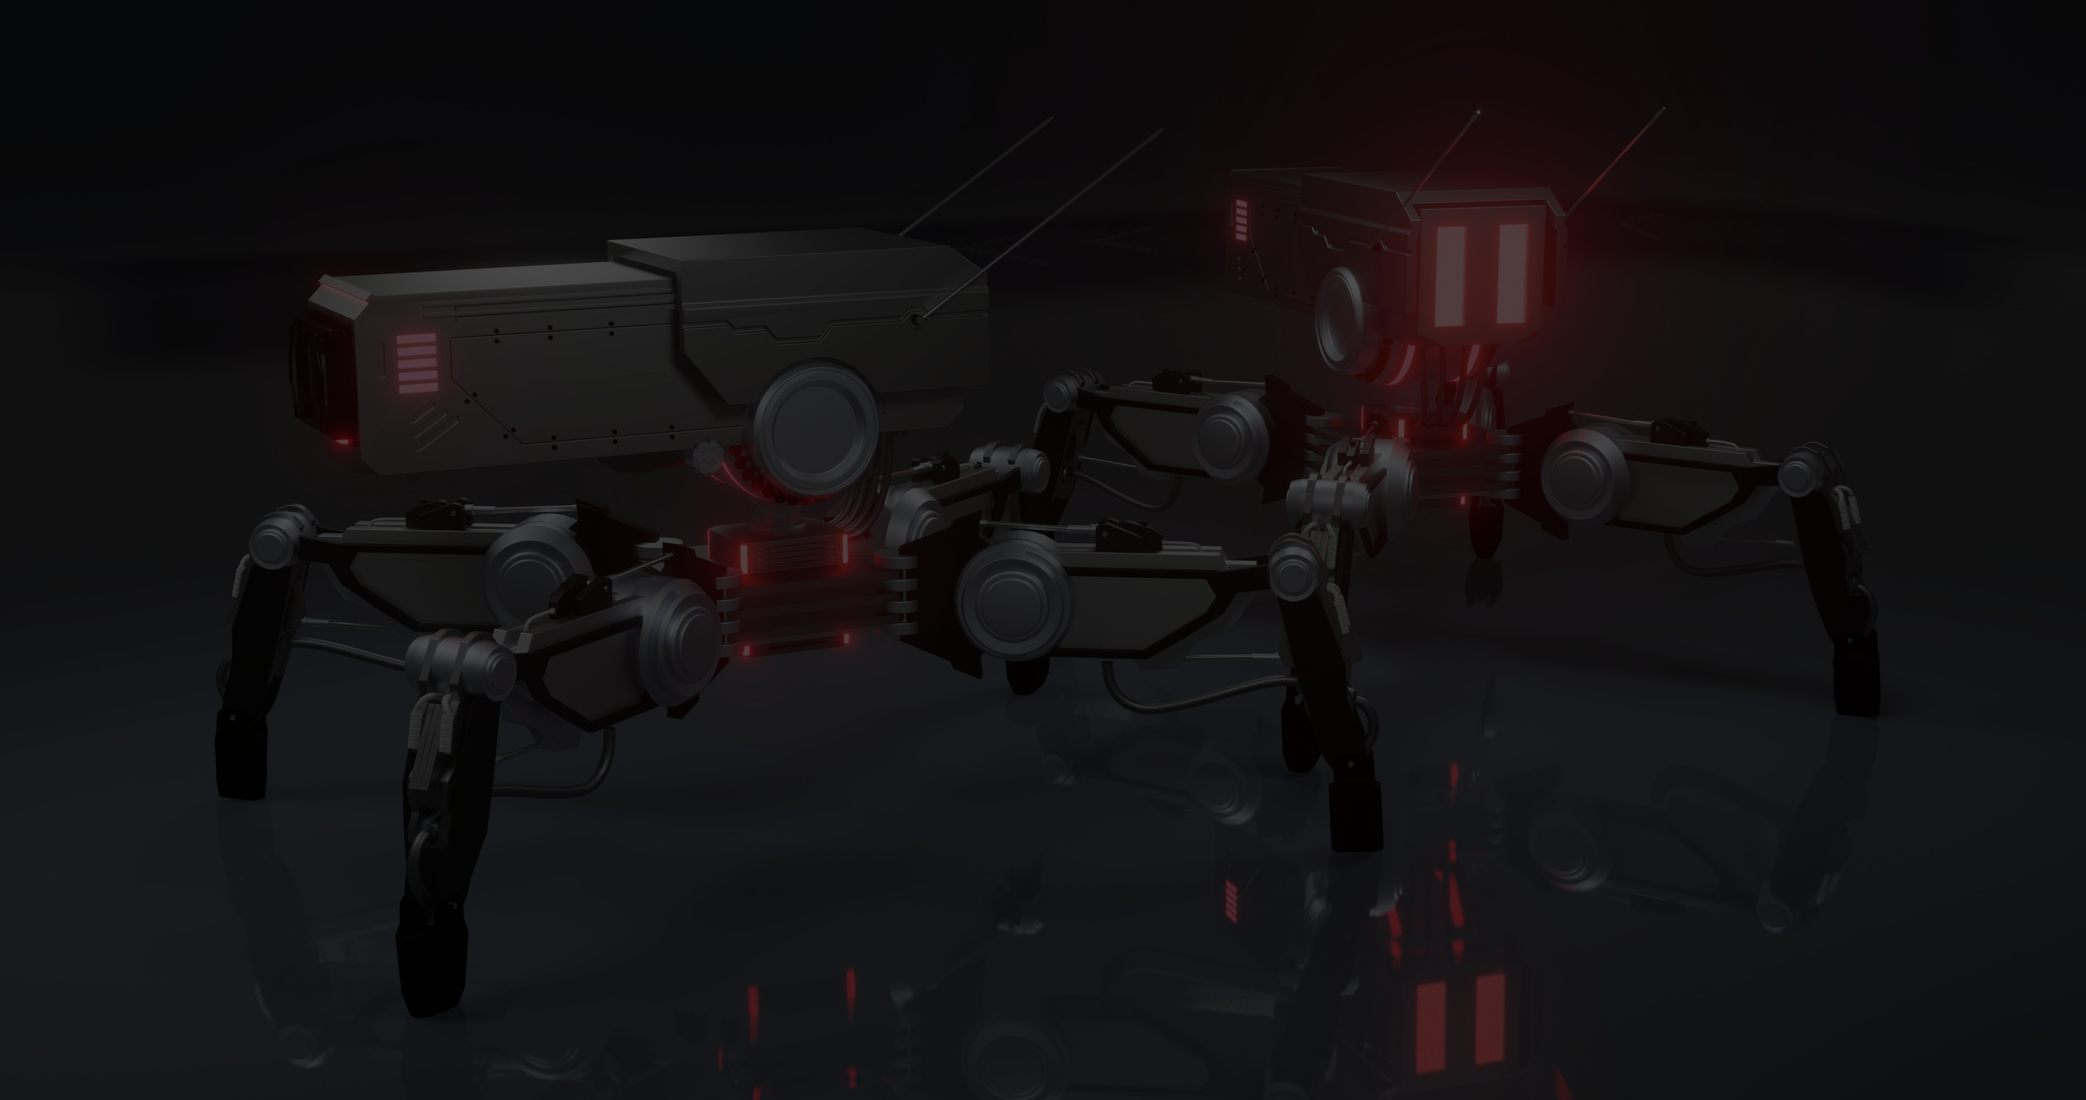


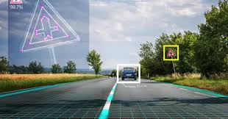
INTRODUCTION & PROBLEM STATEMENT
Autonomous vehicles must accurately recognize traffic signs to ensure safety and compliance with road rules.
Traffic sign recognition helps vehicles interpret road conditions, control flow, and make decisions in real time.
Objective: Build a model to classify traffic signs into 43 categories using the GTSRB dataset.
Challenges:
Varying lighting conditions, image quality, and sign angles.
Need for a robust and accurate system.

Slide 3
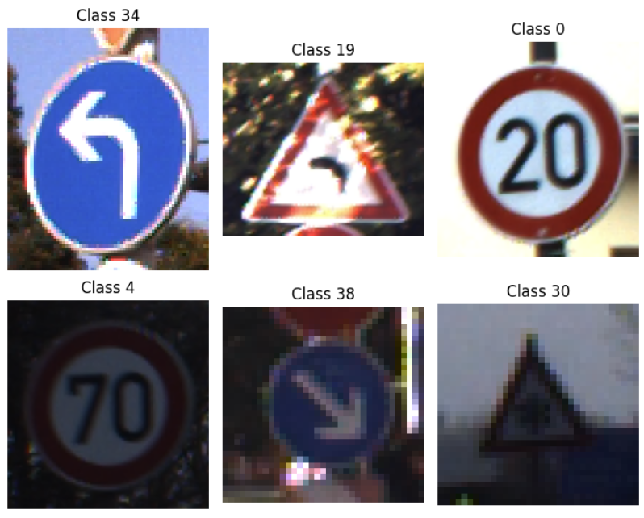
DATASET SELECTION
Dataset: GTSRB (German Traffic Sign Recognition Benchmark)
50,000+ labeled images
43 traffic sign classes (e.g., speed limits, warnings, regulatory signs)
Why GTSRB?
Real-world relevance for autonomous driving.
High variability in angle, lighting, and resolution.
Well-established benchmark in traffic sign classification research.
Class diversity enables better generalization across different road scenarios.

Slide 4
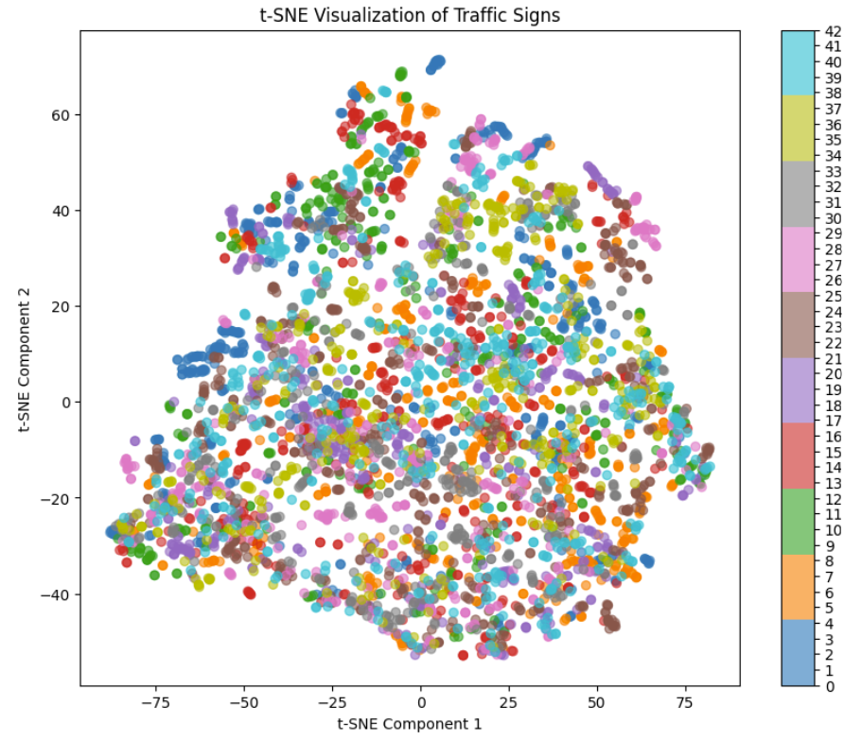
PREPROCESSING
Checked for corrupted images using PIL.Image.open() and img.verify()
t-SNE Visualization
Convert BGR to RGB
Resize to 32x32
Normalize to [0, 1]

Slide 5
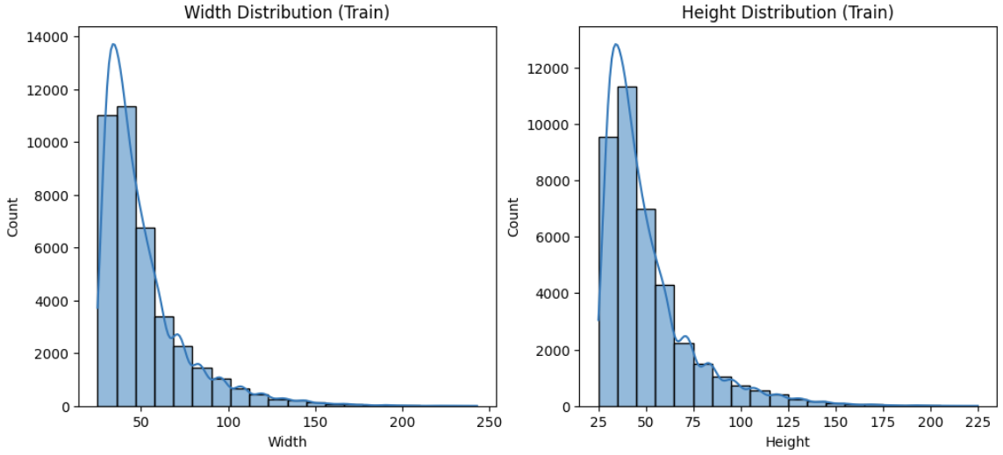
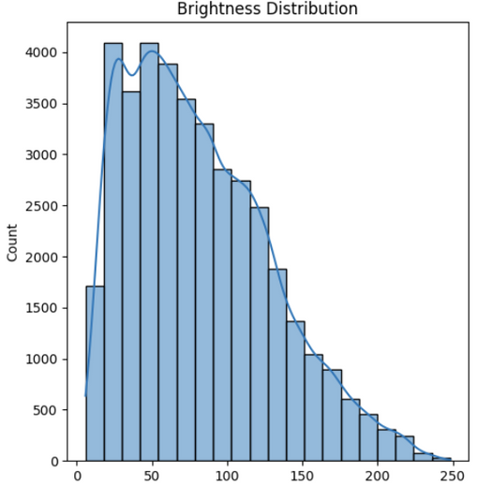
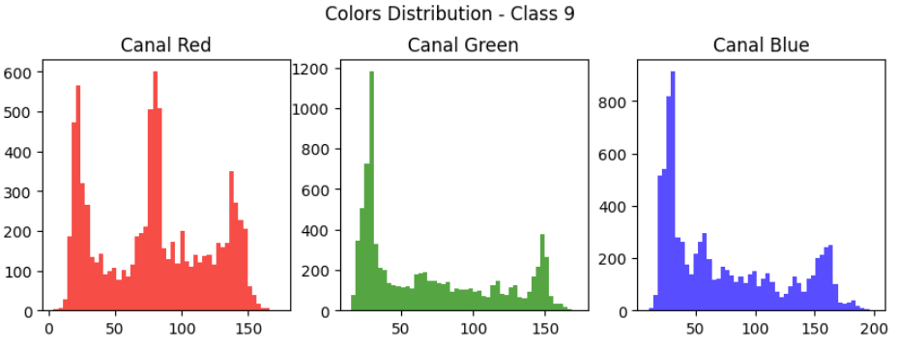
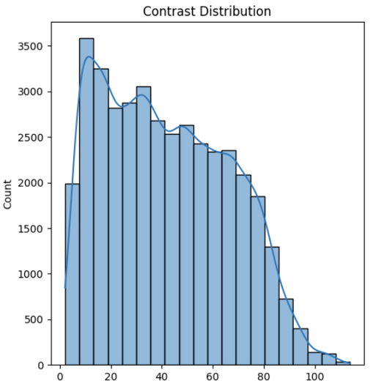
STATISTICS

Slide 6

DATA PREPARATION
&
CNN MODEL IMPLEMENTATION

Slide 7
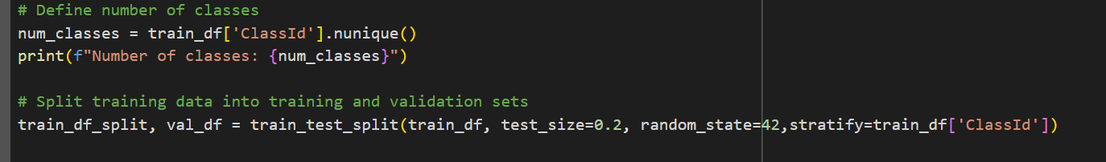

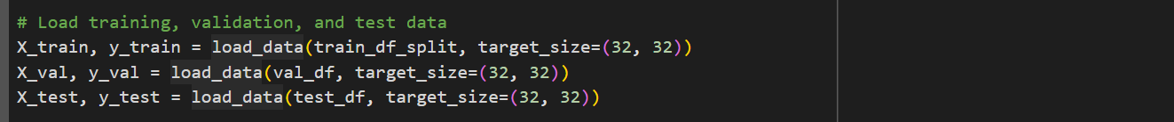
DATA PREPARATION
The dataset is first split into training (80%) and validation (20%) sets using stratified sampling based on class labels (ClassId). This ensures consistent class distribution across subsets, which is especially important for reliable evaluation during training.
The image data is then loaded using a custom load_data function, which resizes all inputs to (32, 32, 3), standardizing the input dimensions for the CNN. This preprocessing step ensures compatibility with the model architecture while helping reduce computational overhead.
Labels from the training, validation, and test sets are converted into one-hot encoded vectors using to_categorical(). This transformation is essential for using categorical cross-entropy loss, which expects target outputs in a probabilistic vector format.

Slide 8
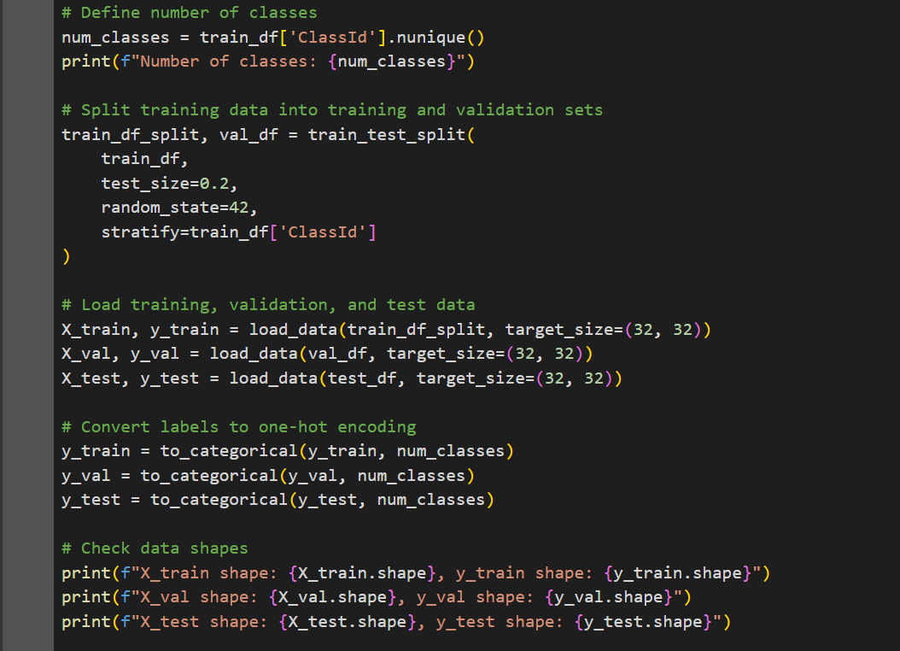
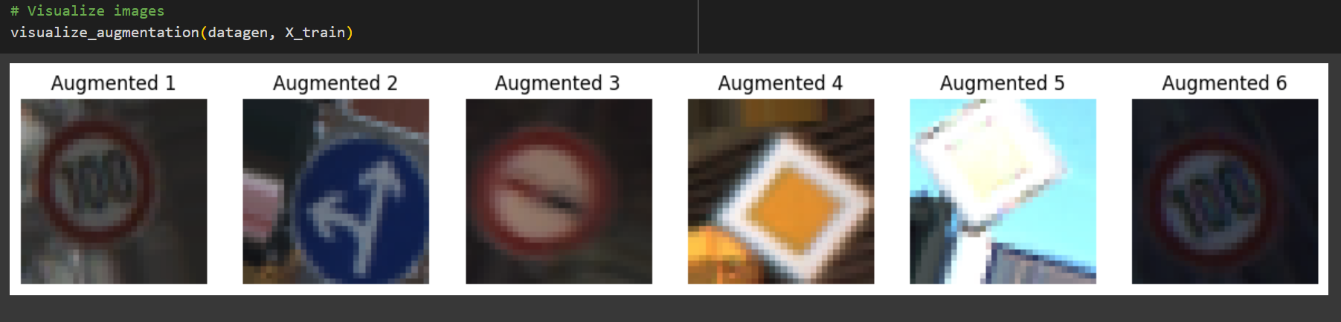
DATA AUGMENTATION
A ImageDataGenerator is configured to apply random transformations to training images, which include:
Rotation: ±30°
Width and height shifts: ±20%
Zooming: ±10%
Fill mode: 'nearest'
The augmentation pipeline is applied to the training set using .fit() before training begins, allowing for seamless integration during the training process.

Slide 9

JUSTIFICATION FOR MODEL APPROACH
Convolutional Neural Networks (CNNs) are widely used in image classification tasks due to their ability to automatically learn spatial hierarchies of features. In traffic sign recognition, CNNs can effectively capture visual patterns and symbol shapes regardless of variations in lighting, angle, or scale. This makes CNNs highly suitable for real-time traffic sign identification in autonomous driving systems.
Advantages of Using CNNs for Traffic Sign Recognition:
Automatic feature extraction without manual preprocessing
High accuracy in visual pattern recognition
Robust to noise, distortion, and varying lighting conditions
Scalable to large datasets with different sign classes
Efficient use of parameters through weight sharing and local connectivity
CNNs are specifically designed for processing grid-like data such as images.
Their architecture mimics the visual cortex, allowing them to learn and generalize visual patterns more efficiently than traditional models. This makes them an ideal solution for identifying and classifying traffic signs in dynamic and unpredictable environments.

Slide 10
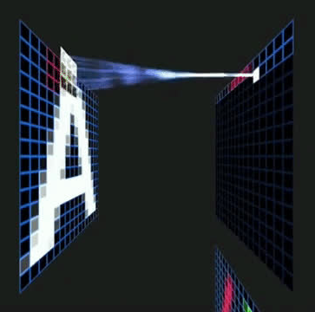
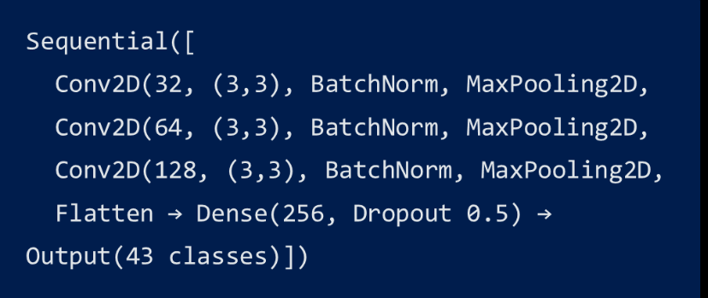
CNN MODEL IMPLEMENTATION
We implemented a Convolutional Neural Network (CNN) using TensorFlow/Keras for multi-class image classification. The model was built with the Sequential API and trained using data augmentation to enhance generalization.
CNN Architecture Details
3. Training Strategy
The model is trained on the augmented training set and validated on a separate validation set. Training history is visualized through accuracy and loss curves.
Input Shape: (32, 32, 3) RGB images
Loss: Categorical Cross-Entropy
Optimizer: Adam
Batch Size: 32
Epochs: 20
Data Augmentation: (ImageDataGenerator) Rotation, Width and height shifts, Zooming, Fillmode
1. The CNN consists of three convolutional blocks, each composed of:
A Conv2D layer with 3×3 kernel and ReLU activation
Batch Normalization to stabilize and accelerate training
MaxPooling2D to reduce spatial dimensions and highlight dominant features
2. The network is flattened and passed through a fully connected layer:
Dense(256, ReLU) to learn complex feature relations
Dropout(0.5) is applied to prevent overfitting
Output layer: Dense(num_classes, softmax) for multi-class classification
4. Evaluation
The model is evaluated on the test set after training, achieving a final test accuracy of approximately 93.17%, indicating strong generalization to unseen data and confirming the effectiveness of the architecture and training strategy.

Slide 11
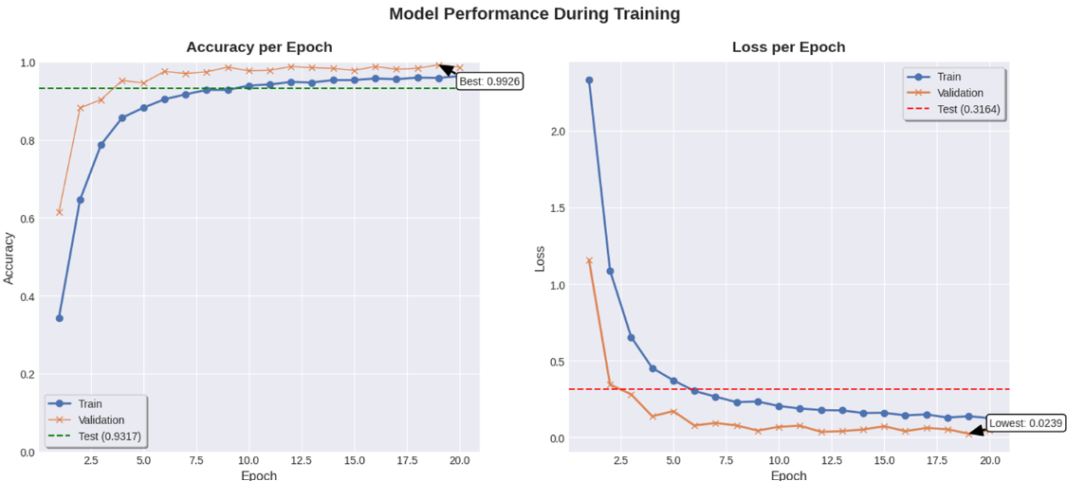
MODEL RESULTS
📈 Accuracy Performance:
Training accuracy improves consistently, from below 40% to over 90% after 10 epochs, showing effective learning.
Validation accuracy quickly reaches ~99% and stays stable, indicating strong generalization.
Test accuracy settles at 93.17%, confirming reliable performance on unseen data.
📉 Loss Performance:
Both training and validation loss decline sharply in early epochs, consistent with efficient convergence.
Validation loss reaches a minimum of 0.024, while test loss remains low at 0.31, with no indication of overfitting throughout training.
⚡Overall Conclusion:
The model shows fast and stable convergence, achieving high accuracy and low loss across all datasets.
The close alignment between training, validation, and test metrics suggests strong generalization and minimal overfitting.

Slide 12
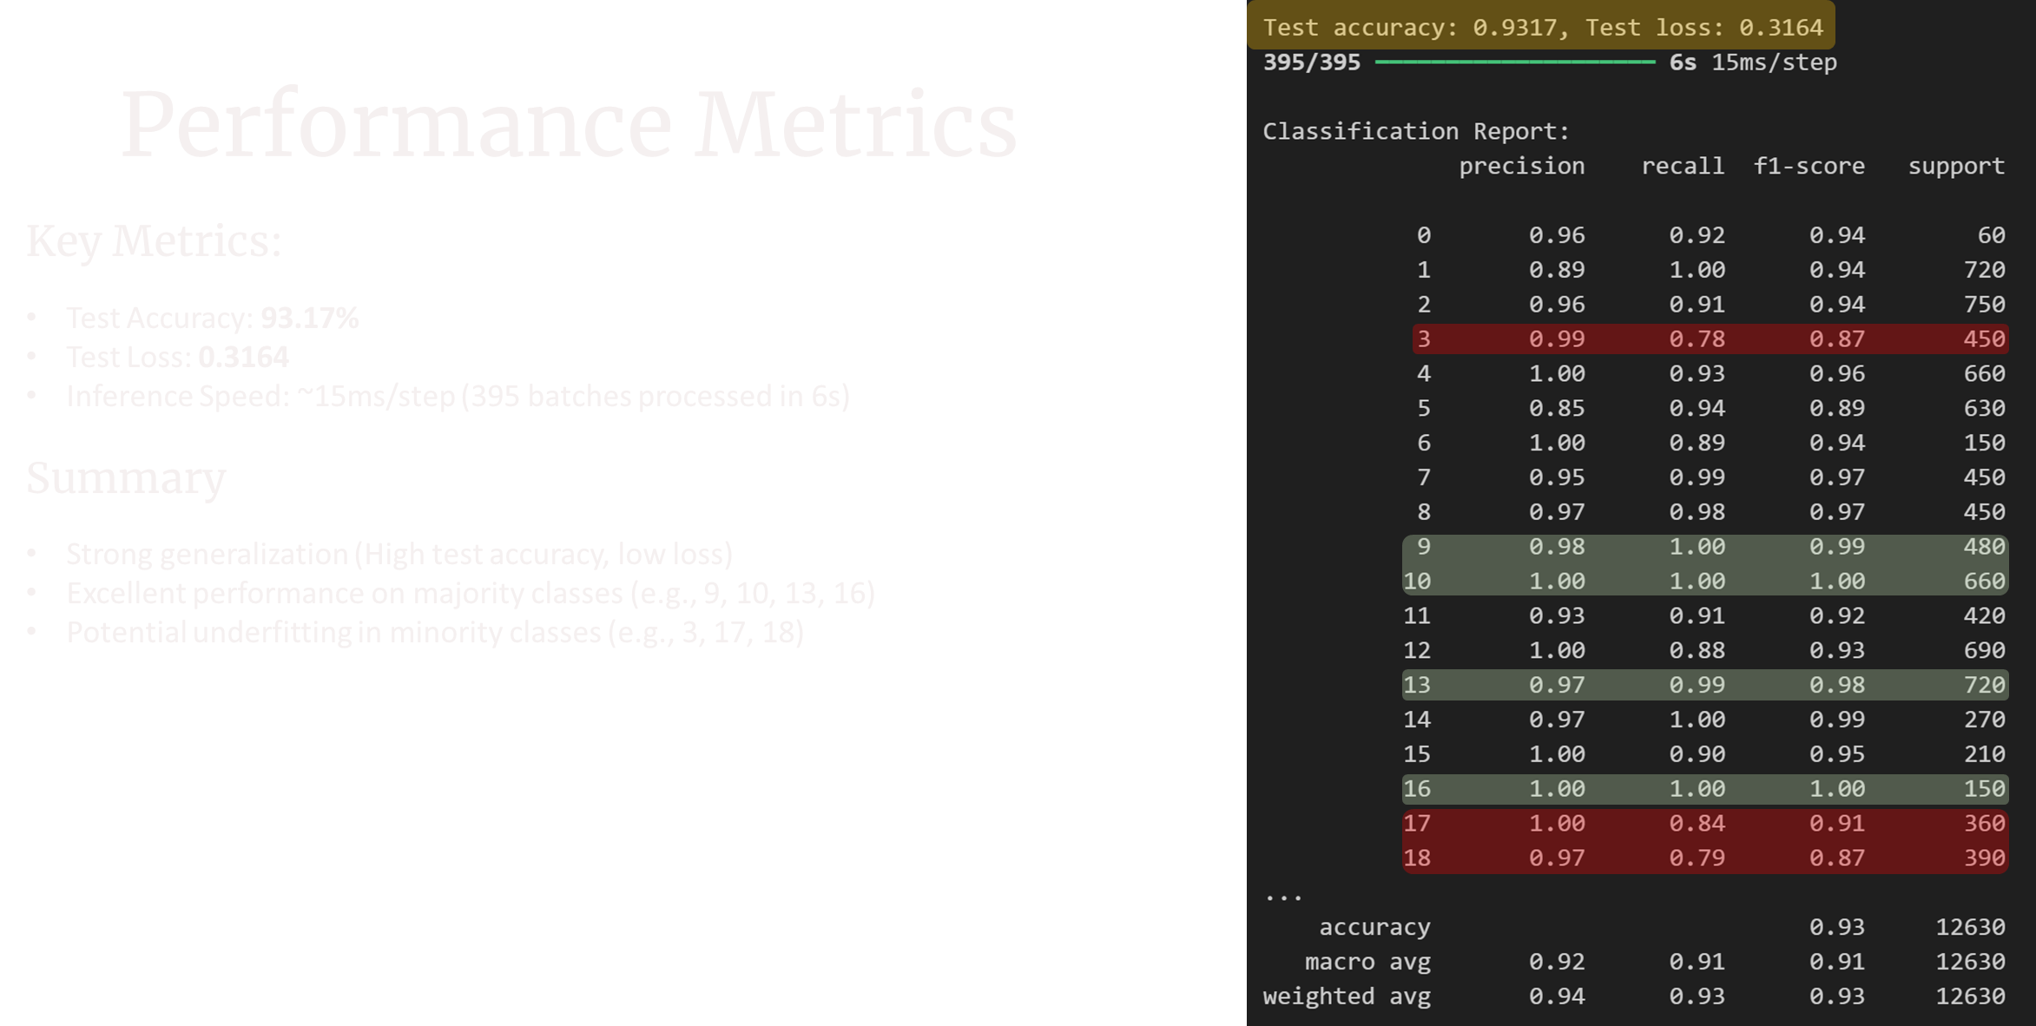

Slide 13
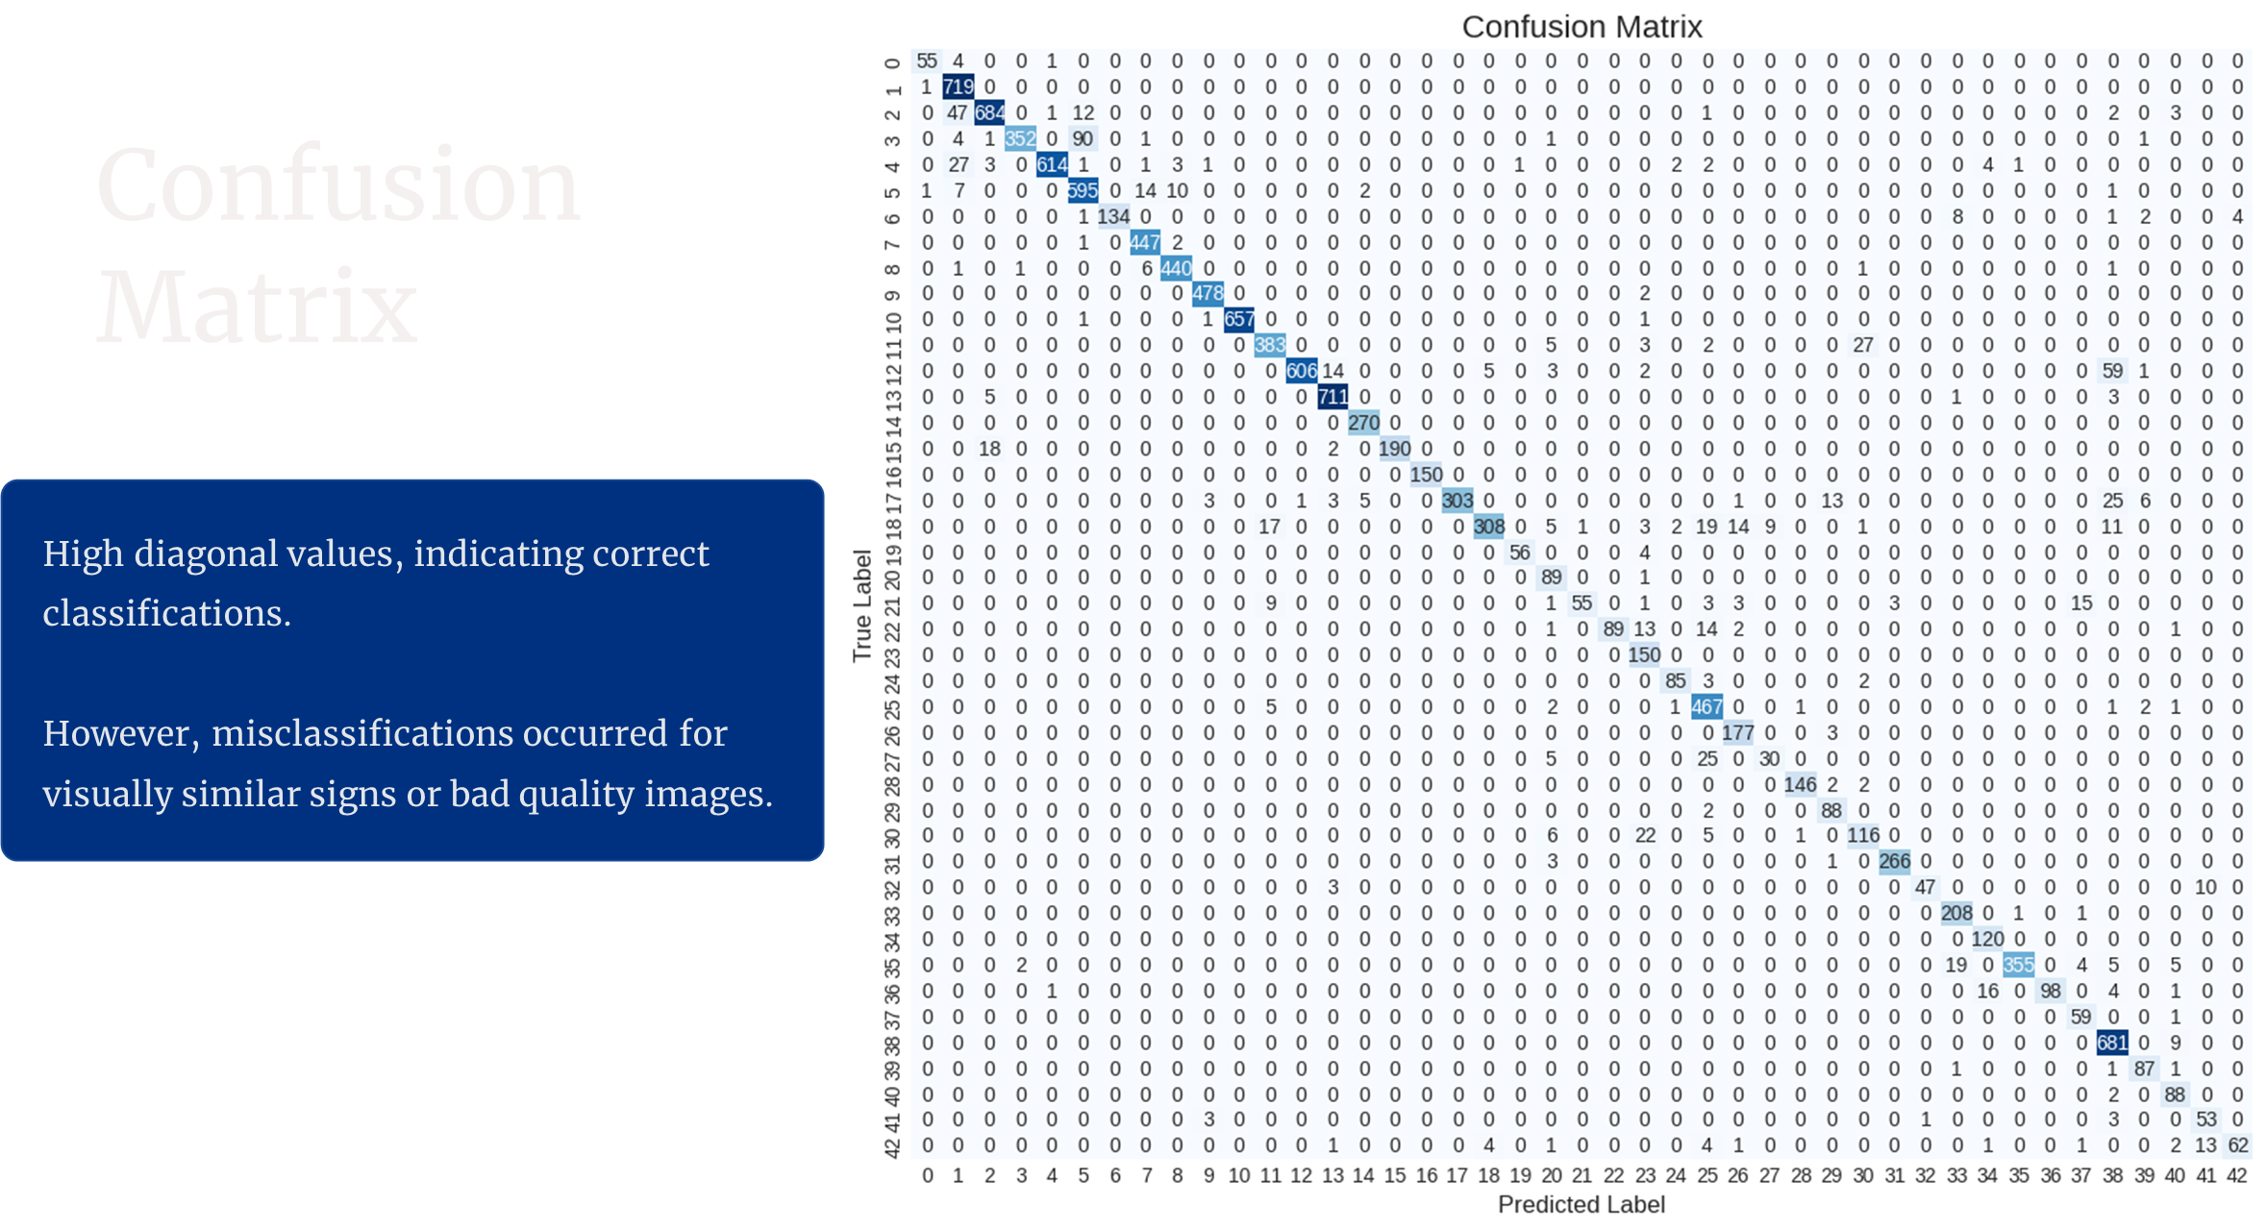

Slide 14
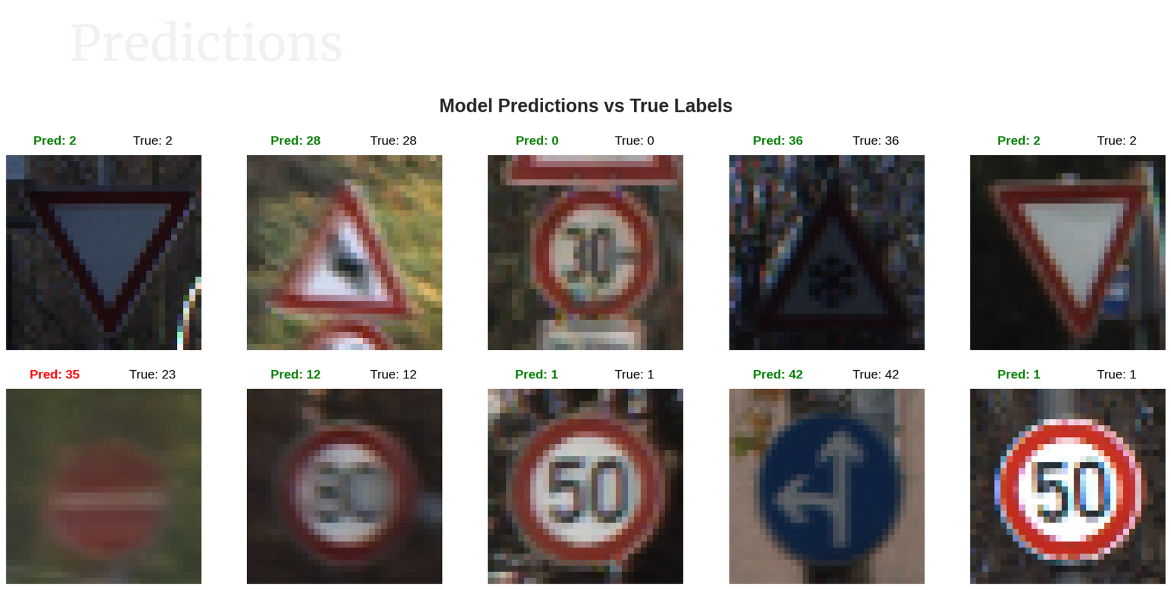
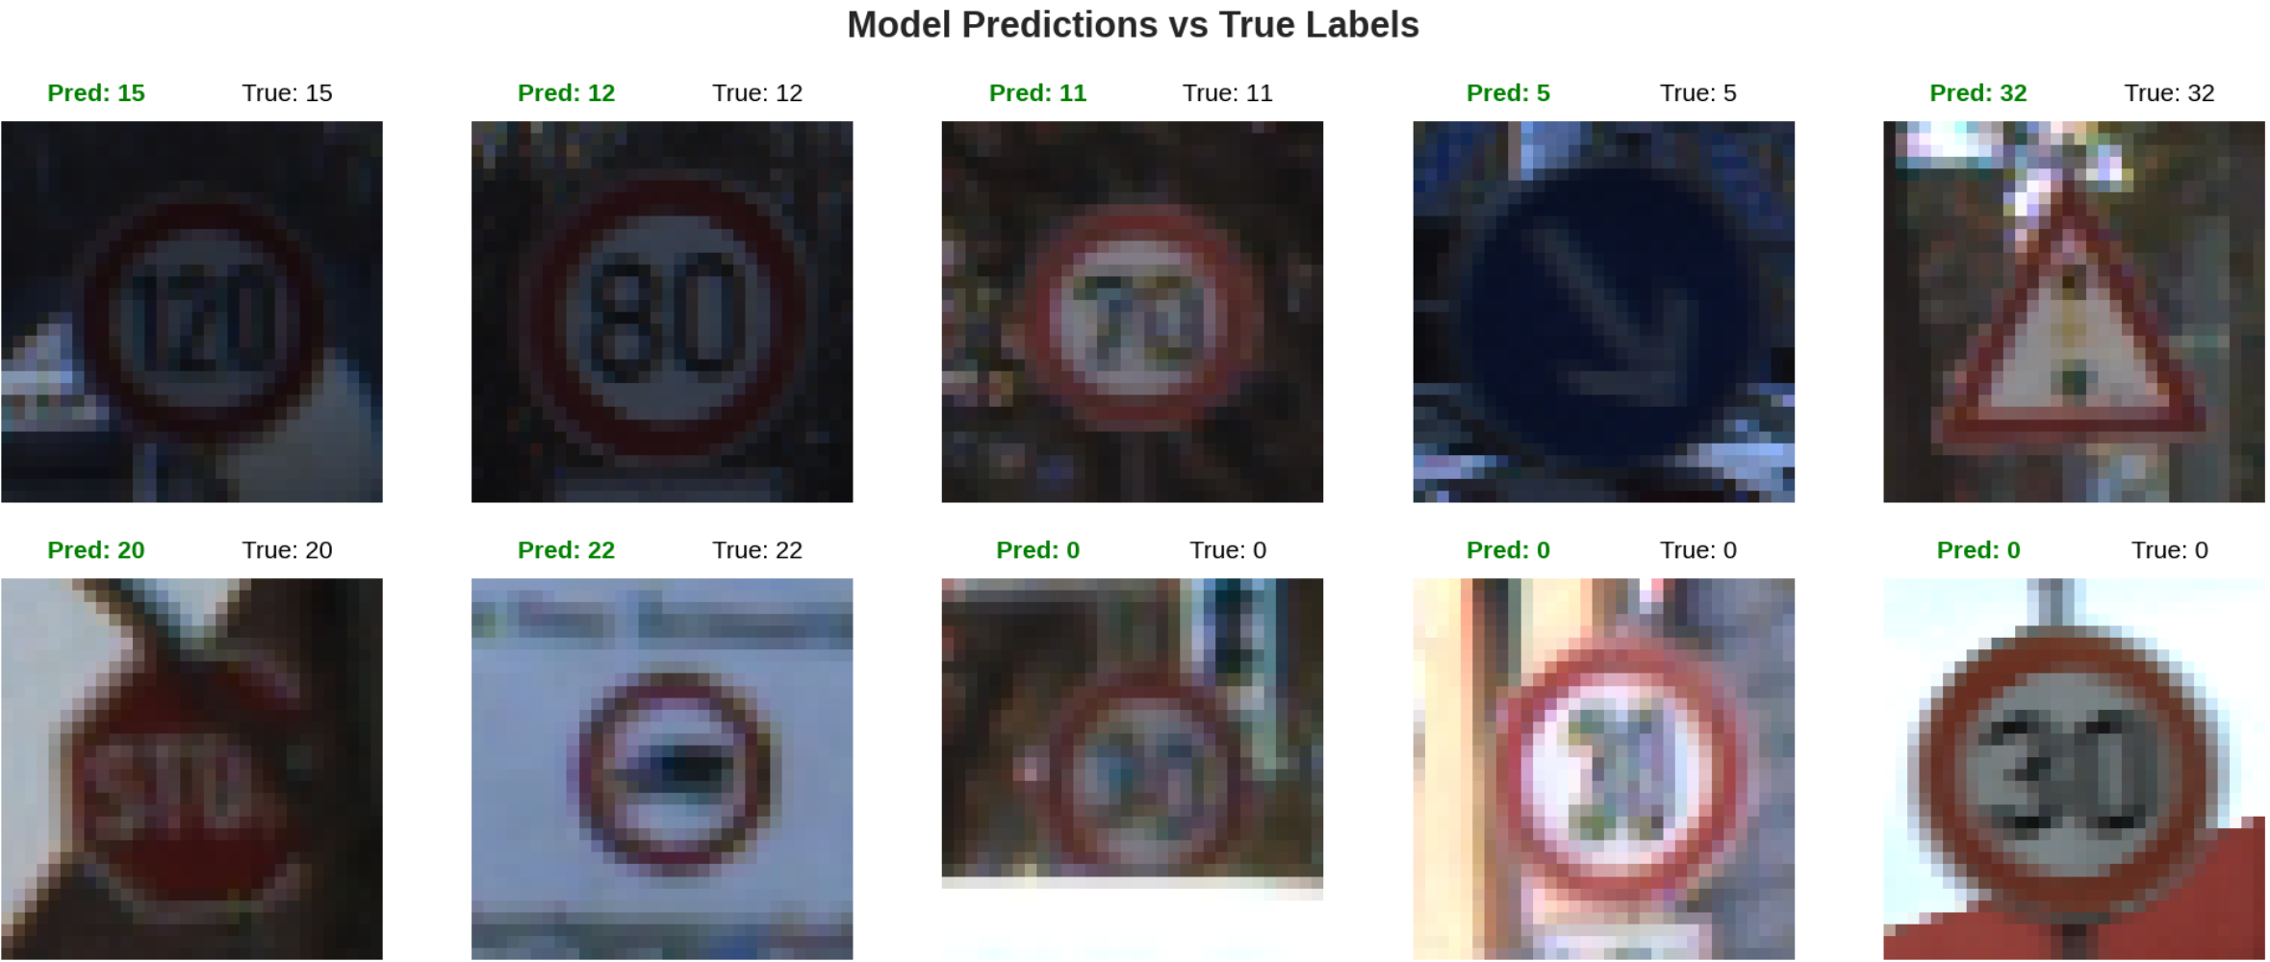

Slide 15
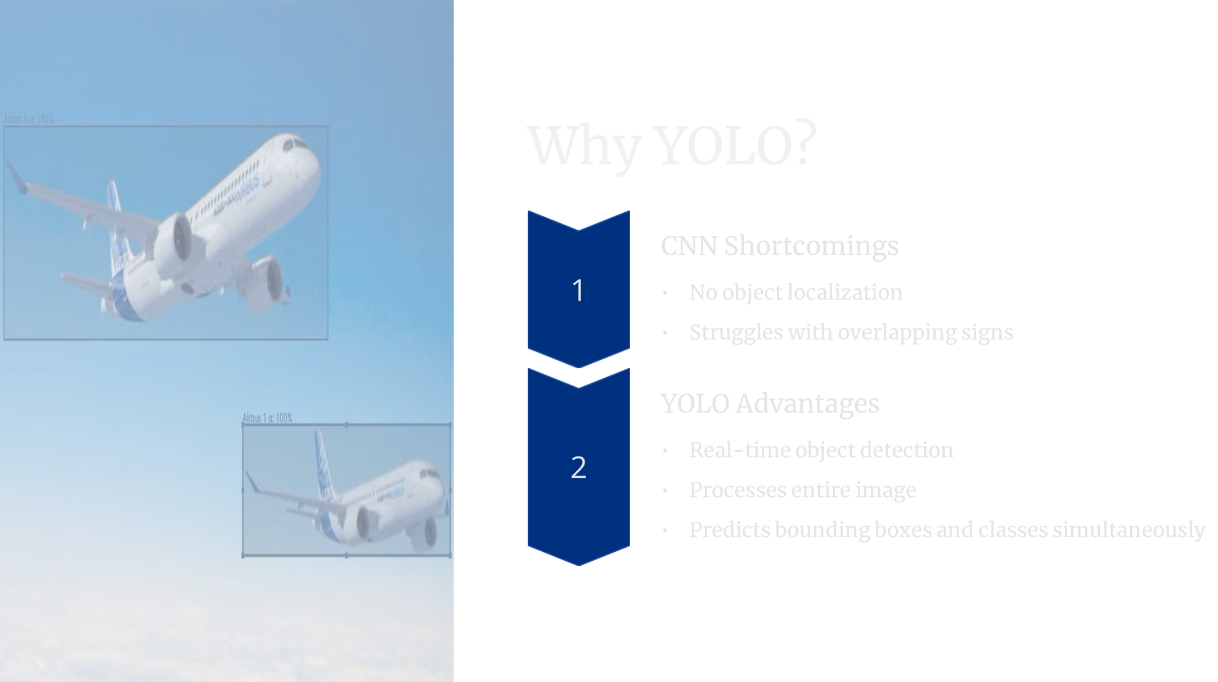

Slide 16

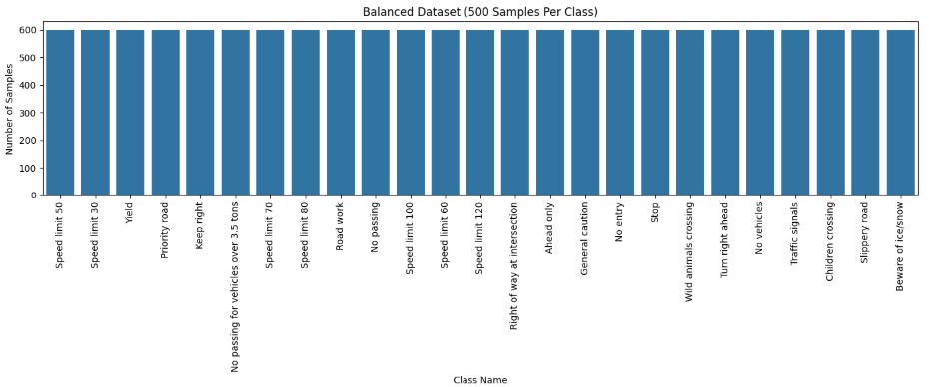
DATASET BALANCING AND YOLO CONVERSION
✅ Dataset Summary
Total Classes: 43
Class Imbalance Observed
(Min: 210 images, Max: 2250 images)
✅ Preprocessing Steps
Split dataset → Train / Validation / Test
Convert annotations to YOLO format
✅ Balancing Strategy
Removed classes with < 500 images
Capped each remaining class to 500 samples
Final dataset: 25 balanced classes
⚖️ Balanced dataset ensures model fairness and reduces class bias.

Slide 17
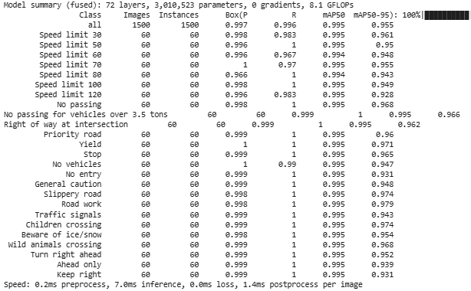
YOLO MODEL IMPLEMENTATION
✅ YOLOv8 Architecture
Lightweight and fast: YOLOv8n selected for limited GPU resources
Pretrained on COCO dataset, then fine-tuned on traffic sign dataset
✅ Customization Steps
Backbone frozen to retain learned features
Detection head replaced to match 25 traffic sign classes
Used data.yaml to automatically load class names and count
✅ Training Configuration
Image size: 256 × 256
Epochs: 15
Batch size: 32
Confidence threshold: 0.3
⚙️ Training Environment
Trained on Google Colab using GPU acceleration

Slide 18
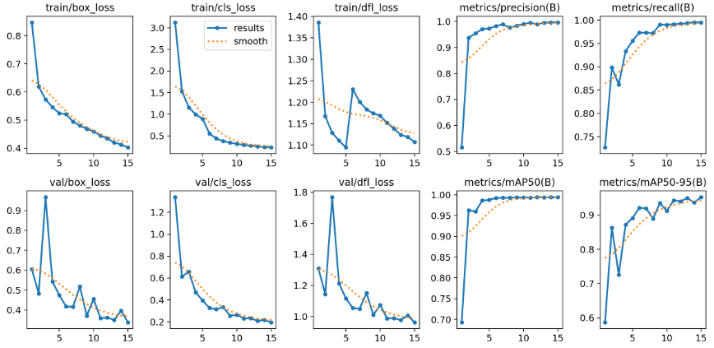
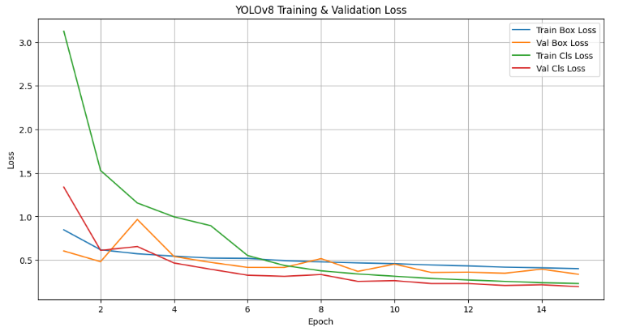
TRAINING PERFORMANCE & EVALUATION METRICS
📉 Training and Validation Loss
The model shows a consistent decrease in both box and classification losses over 15 epochs.
Indicates effective learning and reduction in prediction error as training progresses.
✅ Evaluation Metrics
High Precision and Recall (both approaching 1.0) show strong model performance on validation data.
mAP50 and mAP50-95 metrics steadily improve, reaching above 0.95, indicating good localization and classification performance.
📌 Overall, the model is well-generalized, showing no significant overfitting and achieving strong accuracy across all metrics.

Slide 19
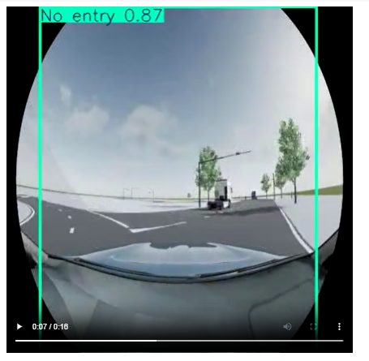
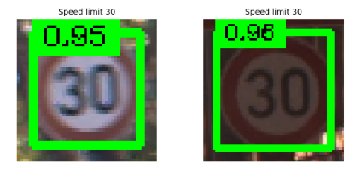
MODEL PREDICTIONS ON IMAGES & VIDEO
Image Predictions
Model performs well on static images from the test set.
Achieves high confidence scores and accurate bounding boxes.
Sample predictions include clear detection of signs like:
“Speed limit 30” → 0.95
“No entry” → 0.87
🎥 Video Inference
The trained YOLOv8 model was tested on a simulated dashcam-style driving video to evaluate real-world applicability.
📌 Real-Time Detection:
The model performed real-time predictions on video frames, detecting and labeling various traffic signs such as:
"🚫 No entry"’, "🛑 Stop", "🚦 Traffic signals"
⚠️ Limitations Observed
Some bounding boxes were imprecise or too large.
Mislabeling occurred occasionally, especially with smaller or blurry signs.
Model performance degraded slightly in continuous video due to limited training data and resource constraints.

Slide 20
CONCLUSION & FUTURE WORK
🧩 Conclusion
This project explored traffic sign recognition using two approaches:
Phase 1/2: CNN architecture for high-accuracy image classification.
Final Phase : Applied YOLOv8 for real-time object detection on a balanced 25-class dataset.
Both models achieved strong results on static images.
YOLOv8 showed potential for real-world detection but struggled with video inference due to data and resource limitations.
🚀 Future Work
Expand dataset with diverse traffic scenes for better generalization.
Apply advanced augmentation (e.g., MixUp, CutMix) and Transformer tuning.
Improve real-time performance via model optimization and temporal smoothing for video.
Explore deployment on mobile and edge devices using quantized models.

Slide 21
REFERENCES
Kaggle. (2011). German Traffic Sign Recognition Benchmark (GTSRB) dataset. Kaggle. https://www.kaggle.com/datasets/meowmeowmeowmeowmeow/gtsrb-german-traffic-sign
TensorFlow. (2023). Image classification with CNNs. TensorFlow Documentation. https://www.tensorflow.org/tutorials/images/cnn
Ultralytics. (2023). YOLOv5: Custom object detection training. GitHub. https://github.com/ultralytics/yolov5
OpenCV. (2023). Image preprocessing techniques. OpenCV Documentation. https://docs.opencv.org/4.x/d9/df8/tutorial_root.html
Roboflow. (2023). What is Data Augmentation? The Ultimate Guide. Roboflow Blog. https://blog.roboflow.com/data-augmentation/
Scikit-learn. (2023). Confusion matrix visualization. scikit-learn Documentation. https://scikit-learn.org/stable/modules/generated/sklearn.metrics.confusion_matrix.html
Papers With Code. (2023). State-of-the-art traffic sign detection models. https://paperswithcode.com/task/traffic-sign-recognition

Slide 22
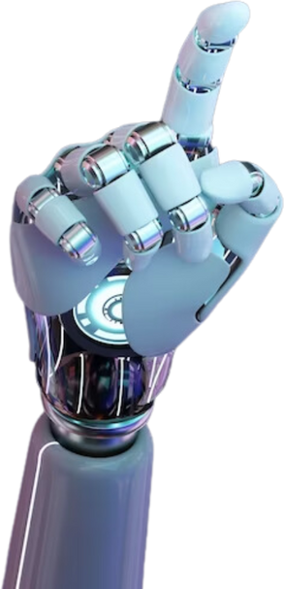
THANK YOU!
Present by
group-8

